Slide 1


Pacific Life
UCI MSBA Capstone Project
Daniel Lee, Irene Yang, Pablo Barajas, Mason Hansen, Abhinav Kashyap

Slide 2
Machine Learning Models
Predict LAPSE Rates
Applicable
Not Applicable
GLM
Poisson Regression
Pablo
Random Forest
Abhinav
Artificial Neural Network
Mason
GLM
Logistic Regression
Pablo
Naïve Bayes
Mason
Support Vector Machine
Daniel
Ensemble Learning Irene

Slide 3
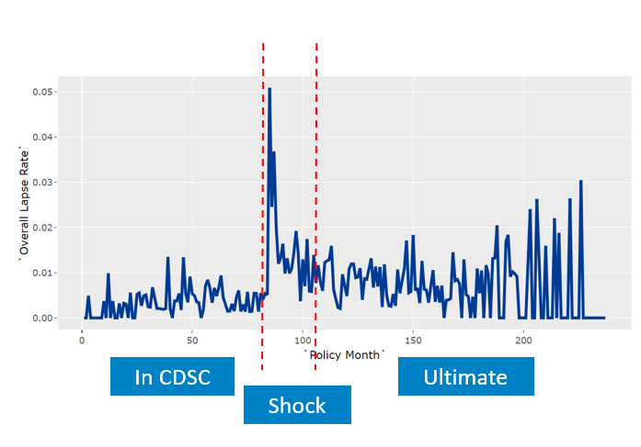
Dataset classification
9 years of data (2010 to 2018), 29 variables
In CDSC
Still in surrender charge period
Very low lapse rates – around 2% annualized
Shock (3,936,058 observations)
24 months after surrender charge ends
Highest lapse rates – around 17% annualized
Ultimate (19,570,757 observations)
everything 25+months after surrender charge ends
Lapse rates around 8% annualized

Slide 4
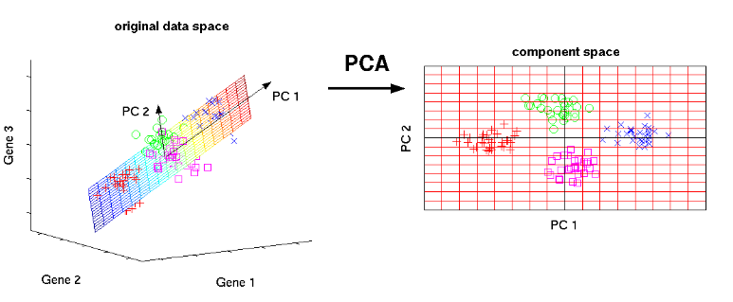
Principal Component Analysis
Principal Component Analysis (PCA) is a technique used to emphasize variation and bring out strong patterns in a dataset. It's often used to make data easy to explore and visualize.
PCA applied into the Artificial Neural Networks and Random Forest those 'black box' non-parametric models in this project. GLM is a linear model, variables importance can be easy to observe and find out.

Slide 5
Limitation
Logistic Regression (LR)
LR is one of the basic and popular algorithms to solve a classification problem, which means that it is a great model to use when one is predicting a binary output. Since the project is to predict the lapse rate, the output of the prediction will not be binary. As a result, LR did not perform as well as other machine learning models.
Support Vector Machine (SVM)
The most serious problem with SVM is the high algorithmic complexity and extensive memory requirements of the predictive programming in large-scale tasks. Additionally, LR and SVM with linear Kernel generally perform comparably in practice because SVM is also primarily for classification problems; therefore, it was also not a good fit in predicting the lapse rate.
Naive Bayes (NB)
NB is a perfect probability-based method, it gives user a well-estimated value; nevertheless, a big data set is often needed in order to make reliable estimations of the probability of each class. Also, it has strong feature independence assumptions. Indeed, NB is a classifier (1,0); thus, the output could not be coerced into a lapse rate.

Slide 6
GLM: Generalized Linear Model - Poisson Regression with Log Link
GLM: Poisson with log link
GLM takes the traditional LM (y = mx + b) and relaxes some of the constraints - makes it more appropriate for insurance.
Poisson: Distribution of the underlying variable (lapses)
Log Link: Instead of modeling y = mx + b - we model log(y) = mx + b
* Nice thing about log link is we can re-state this formula as: y = exp(mx + b) OR y = exp(mx) * exp(b)
* In other words, changing your predictor variable has a multiplicative effect on lapses instead of additive
Interested in Lapse RATE not number of lapses:
In our model: log(y) = mx + b y = number of lapses
To change this to a prediction of lapse rates - we make the following adjustment:
log(y) = log(exposure) + mx + b
REARRANGE:
log(y) - log(exposure) = mx + b
exp(log(y) - log(exposure)) = exp(mx + b)
exp(log(y))/exp(log(exposure)) = exp(mx) * exp(b)
y/exposure = exp(mx) * exp(b): y/exposure is number of lapses/exposure = lapse rate
Notes:
Poisson Regression is a form of regression analysis used to model count data

Slide 7
Model
Lapse ~ offset(log(exposure)) + Months_after_cdsc + ITM_group + Age_group*Qualification + log(total_premium) + factor(DB_Mapping) + Comm_opt + wd_prem_ratio + Channel
Deviance | RMSE
42,766 | 0.08426
Notes:
An offset term is used for a covariate with *known* slope.

Slide 8
K-Fold Cross-Validation
The original Dataset is randomly partitioned into k equal sized subsamples
The goal of cross-validation is to test the model's ability to predict new data that was not used in estimating it
Full Data
Fold 1
Fold 2
Fold 3
Fold 4
Fold 5
Fold 6
Fold 7
Fold 8
Fold 9
Fold 10
Notes:
Cross validation uses 9 blocks to train and 1 to test, this process is repeated 10 times with every block used for testing and therefore building a more robust model. It keeps track of how well the method performed
OF the k-subsamples a single subsample is retained as the validation data for testing the model and the remaining k-1 subsamples are used as training data
This cross validation process is then repeated k times with each of the subsamples used exactly once as the validation data
The k results from the folds can then be averaged and combined to produce a single estimation
The advantage o doing this, is that all observations are used for both training and validation plus each observation is used for validation exactly once

Slide 9
K-Fold Cross-Validation
Full Data
Fold 1
Fold 2
Fold 3
Fold 4
Fold 5
Fold 6
Fold 7
Fold 8
Fold 9
Fold 10
Training
Testing
Notes:
Cross validation uses 9 blocks to train and 1 to test, this process is repeated 10 times with every block used for testing and therefore building a more robust model. It keeps track of how well the method performed
OF the k-subsamples a single subsample is retained as the validation data for testing the model and the remaining k-1 subsamples are used as training data
This cross validation process is then repeated k times with each of the subsamples used exactly once as the validation data
The k results from the folds can then be averaged and combined to produce a single estimation
The advantage o doing this, is that all observations are used for both training and validation plus each observation is used for validation exactly once

Slide 10
K-Fold Cross-Validation
Full Data
Fold 1
Fold 2
Fold 3
Fold 4
Fold 5
Fold 6
Fold 7
Fold 8
Fold 9
Fold 10
Training
Testing
Notes:
Cross validation uses 9 blocks to train and 1 to test, this process is repeated 10 times with every block used for testing and therefore building a more robust model. It keeps track of how well the method performed
OF the k-subsamples a single subsample is retained as the validation data for testing the model and the remaining k-1 subsamples are used as training data
This cross validation process is then repeated k times with each of the subsamples used exactly once as the validation data
The k results from the folds can then be averaged and combined to produce a single estimation
The advantage o doing this, is that all observations are used for both training and validation plus each observation is used for validation exactly once

Slide 11
K-Fold Cross-Validation
Full Data
Fold 1
Fold 2
Fold 3
Fold 4
Fold 5
Fold 6
Fold 7
Fold 8
Fold 9
Fold 10
Training
Testing
Notes:
Cross validation uses 9 blocks to train and 1 to test, this process is repeated 10 times with every block used for testing and therefore building a more robust model. It keeps track of how well the method performed
OF the k-subsamples a single subsample is retained as the validation data for testing the model and the remaining k-1 subsamples are used as training data
This cross validation process is then repeated k times with each of the subsamples used exactly once as the validation data
The k results from the folds can then be averaged and combined to produce a single estimation
The advantage o doing this, is that all observations are used for both training and validation plus each observation is used for validation exactly once

Slide 12
Model Comparison
 | GLM – Poisson | Random Forest | Neural Networks | Current PL GLM
Interpretability |  |  |  | 1
Computational Efficiency |  |  |  | 2
In Seriatim |  |  |  | 1
Model Performance |  |  |  | 3
Interpretability
How easily interpretable are the results of the model?
Computational Efficiency
How much computing power is needed to run the model on a full dataset
In Seriatim
How easily applicable is the model on a test set to predict lapse rates seriatim
Model Performance
Goodness of fit tests, such as Root Mean Squared Error (RMSE)
Benchmark
Current Pacific Life GLM model
Notes:
se·ri·a·tim - taking one subject after another in regular order; point by point.
This implies calculation results are produced for each database record explicitly, i.e. without model compression (data grouping) and before summation.

Slide 13
Model Comparison
Models
Generalized Linear Model – Poisson Regression
Highly interpretable parametric model
Computationally efficient
Easily applicable to predict seriatim
RMSE = 0.08426
 | GLM – Poisson | Random Forest | Neural Networks | Current PL GLM
Interpretability | 1 |  |  | 1
Computational Efficiency | 2 |  |  | 2
In Seriatim | 1 |  |  | 1
Model Performance | 3 |  |  | 3

Slide 14
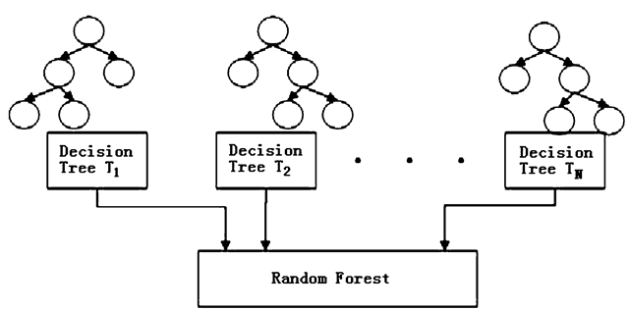
Random Forest (RF)

Slide 15
Random Forest Overview
How it works:
Large number of 'Decision trees' merged together to get a more accurate and stable prediction
Feature Importance:
Measure the relative importance of each feature on the prediction - Decide which features you may want to drop, because they don’t contribute enough to the prediction process.
Hyperparameter Optimization:
Fine-tune the model results to increase the predictive power such as:
Number of trees built (more trees imply more accurate predictions)
Features to split (Number of features considered for a split)
Notes:
With under-sampling, we randomly select a subset of samples from the class with more instances to match the number of samples coming from each class. The main disadvantage of under-sampling is that we lose potentially relevant information from the left-out samples
With oversampling, we randomly duplicate samples from the class with fewer instances or we generate additional instances based on the data that we have. we also run the risk of overfitting our model

Slide 16
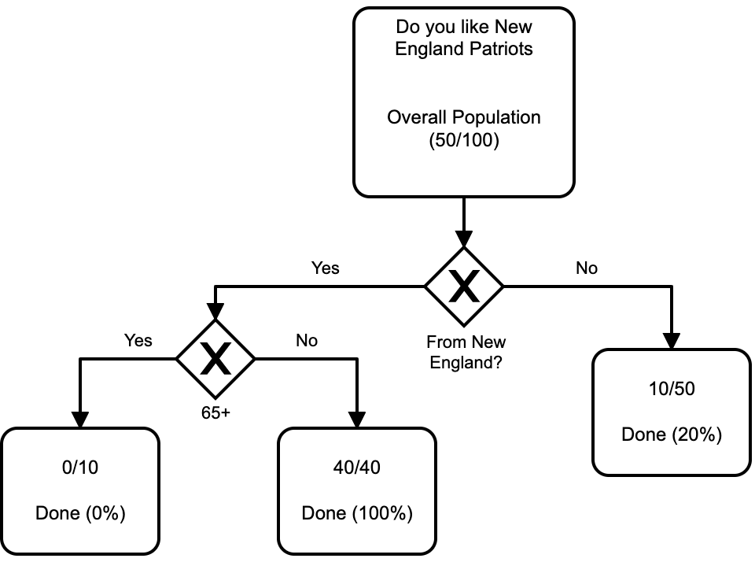
Random Forest Example
50% of the overall population like the Patriots
The model is trying to make splits to ultimately get a group of people as close to 100% and 0% as possible.
The model results:​
Not from NE: 20%​
From NE and 65+: 0%​
From NE and <65: 100%​
Objective:
Predicting the likelihood of lapse using mutiple splits on the given features for each policy holder.
Notes:
With under-sampling, we randomly select a subset of samples from the class with more instances to match the number of samples coming from each class. The main disadvantage of under-sampling is that we lose potentially relevant information from the left-out samples
With oversampling, we randomly duplicate samples from the class with fewer instances or we generate additional instances based on the data that we have. we also run the risk of overfitting our model

Slide 17
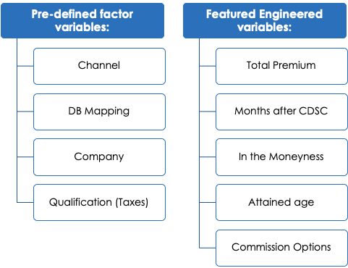
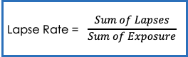
Data aggregation - Important variables
Total 9 variables considered to create an aggregated dataset.
The data aggregation was done by:
Sum of Exposure
Sum of Lapses
Calculate the Lapse rate for predictions:
Notes:
With under-sampling, we randomly select a subset of samples from the class with more instances to match the number of samples coming from each class. The main disadvantage of under-sampling is that we lose potentially relevant information from the left-out samples
With oversampling, we randomly duplicate samples from the class with fewer instances or we generate additional instances based on the data that we have. we also run the risk of overfitting our model

Slide 18
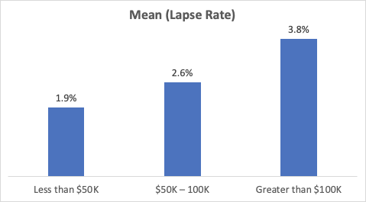
Total Premium amount
The Total Premium amount was divided into 3 categories:
Band Range | Sum of Lapses | Mean (Lapse Rate) | Annualized Lapse Rate
Less than $50K | 13886 | 1.9% | 20.6%
$50K – 100K | 6210 | 2.6% | 27.1%
Greater than $100K | 8610 | 3.8% | 37.2%

Slide 19
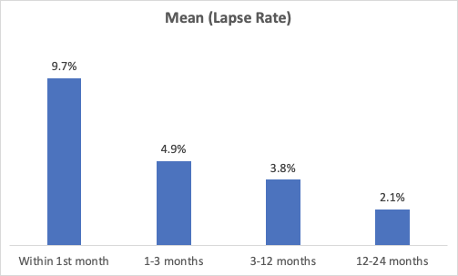
Months after CDSC
The Shock dataset consists of polices which lapse in the 24 months following the end of CDSC period.
Band Range | Sum of Lapses | Mean (Lapse Rate) | Annualized Lapse Rate
Within 1st month | 5203 | 9.7% | 70.6%
1-3 months | 4038 | 4.9% | 45.3%
3-12 months | 9141 | 3.8% | 37.2%
12-24 months | 10324 | 2.1% | 22.5%

Slide 20
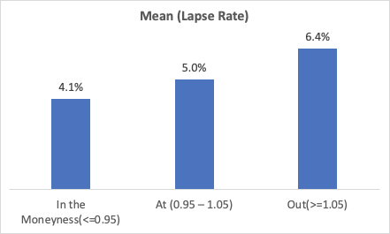
In-The-Moneyness
The In-the-moneyness factor is defined as Contract value/ GMDB Base and its range varies from 0-2
Band Range | Sum of Lapses | Mean (Lapse Rate) | Annualized Lapse Rate
In the Moneyness(<=0.95) | 3105 | 4.1% | 39.5%
At (0.95 – 1.05) | 5899 | 5% | 46%
Out(>=1.05) | 19702 | 6.4% | 54.8%

Slide 21
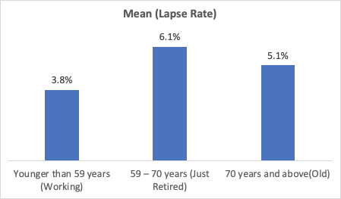
Attained Age
The attained age was divided into 3 age groups:
Band Range | Sum of Lapses | Mean (Lapse Rate) | Annualized Lapse Rate
Younger than 59 years (Working) | 9092 | 3.8% | 37.2%
59 – 70 years (Just Retired) | 11188 | 6.1% | 53%
70 years and above(Old) | 8426 | 5.1% | 46.6%

Slide 22
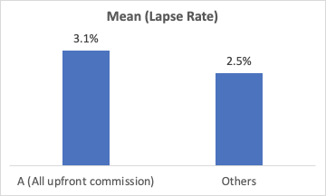
Commission Option
The Commission options were divided into 2 categories:
Band Range | Sum of Lapses | Mean (Lapse Rate) | Annualized Lapse Rate
A (All upfront commission) | 19698 | 3.1% | 31.5%
Others | 9008 | 2.5% | 26.2%

Slide 23
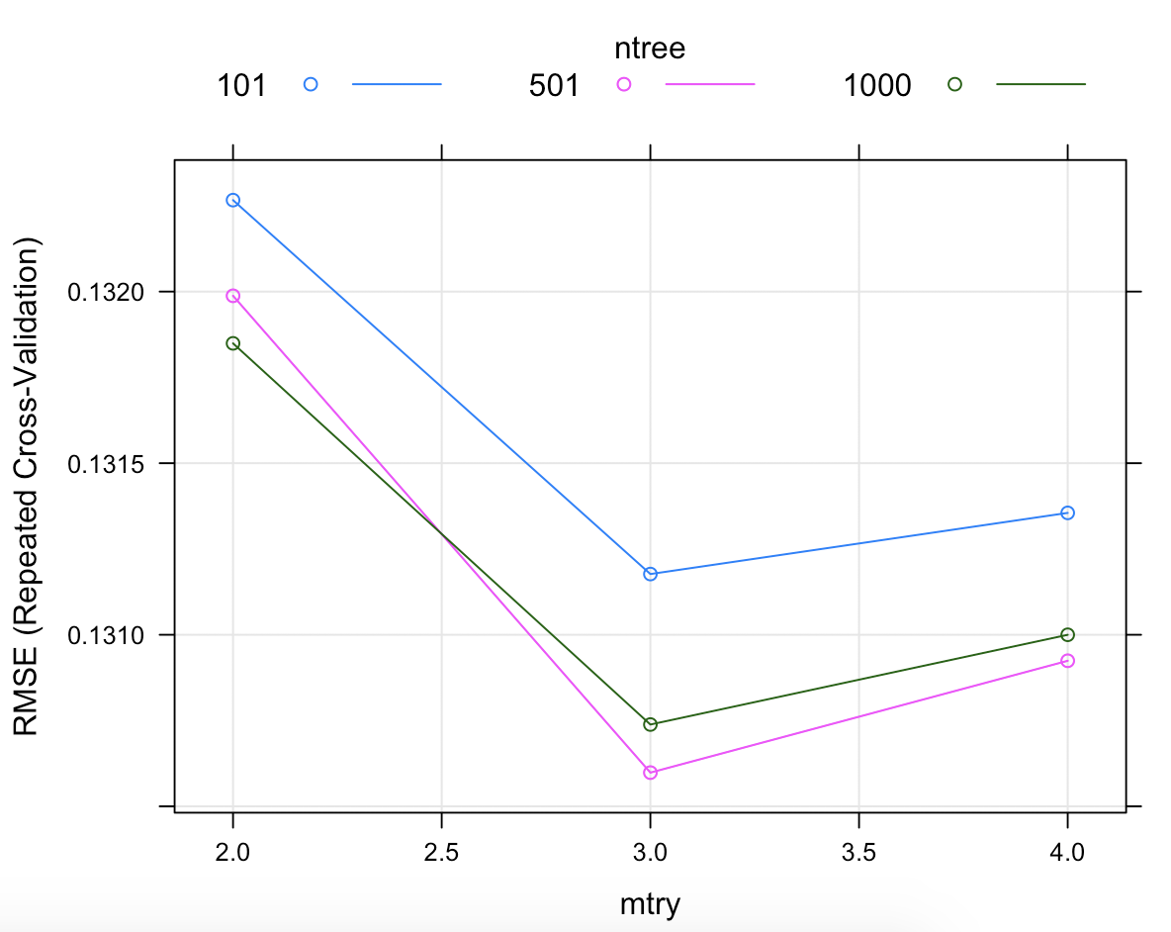
Random Forest - Model Parameters
Mtry : Number of variables available for splitting at each tree node. For regression models, an ideal value is the number of predictor variables divided by 3 (rounded down)
Ntree : Number of trees to grow
Larger number of trees produce more stable models and covariate importance estimates but require more memory and a longer run time.
Model Training:
10-fold cross-validation on the aggregated dataset
Ideal values to achieve lowest RMSE:
Mtry = 3
Ntree = 500

Slide 24
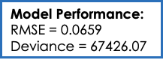
Model Results
A random forest is made from multiple decision trees.
Each tree individually predicts for given data using a random set of 3 features and random forest model
suggests an overall prediction by averaging results across 500 trees!!
​Feature importance (Relative) is useful to analyze which features are the most important in our model
Feature Name | Overall
months_after_cdsc | 100
premium_bands | 5.29
comm_opt_factor | 4.128
Qualification | 3.133
itm_factor | 3.125
Channel | 3.107
DB_Mapping | 2.41
company | 0.306
age_group | 0

Slide 25
Model Comparison
Models
Generalized Linear Model – Poisson Regression
Highly interpretable parametirc model
Computationally efficient
Easily applicable to predict seriatim
RMSE = 0.08426
Random Forest
Less interpretable non-parametric model
Computationally efficient
Not easily applicable seriatim, aggregated model
RMSE = 0.0659
 | GLM – Poisson | Random Forest | Neural Networks | Current PL GLM
Interpretability | 1 | 2 |  | 1
Computational Efficiency | 2 | 1 |  | 2
In Seriatim | 1 | 3 |  | 1
Model Performance | 3 | 2 |  | 3

Slide 26

Artificial Neural Networks (ANN)

Slide 27
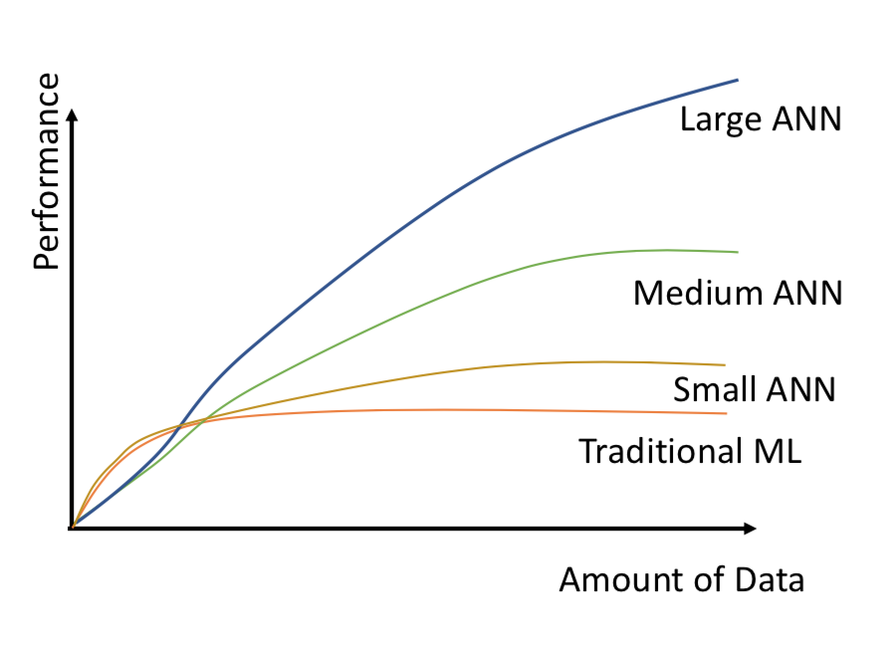
Why Artificial Neural Networks?
Artificial Neural Networks vs. Traditional Machine Learning Techniques
In general, better performance
More flexibility with large datasets
Ability to learn patterns & interactions
Less importance on feature engineering
More adaptable to non-linear problems

Slide 28
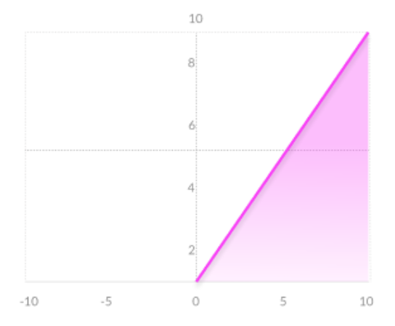
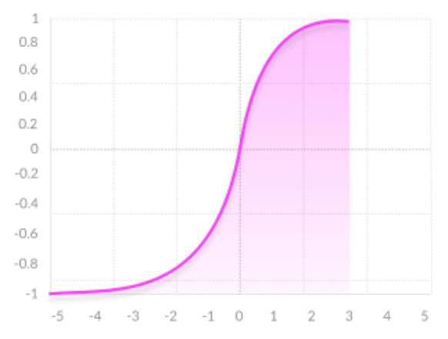
Artificial Neural Network Structure
Input Layer
Predictor variables
Hidden Layers & Nodes
Ability to specify activation function at each layer
Action at each node:
Input Data→ Apply Activation Function → Output Data
Activation Functions
Rectified Linear Units (Most basic activation function for regression problems)
Hyperbolic Tangent (Better output function for continuous values between 0 and 1)
Smooth Gradient
Similar to a sigmoid function, but handles values closer to 0 and 1 better

Slide 29
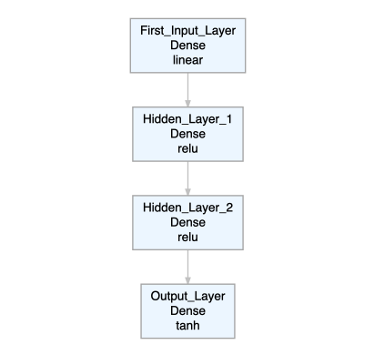
Applied Neural Network Structure
Keras Neural Network Model (from Tensor Flow)
Fully Connected Sequential Network​
Layers
Input layer
Two hidden layers​ -- Rectified Linear Units (ReLU)
Output layer – Hyperbolic Tangent (Tanh)

Slide 30
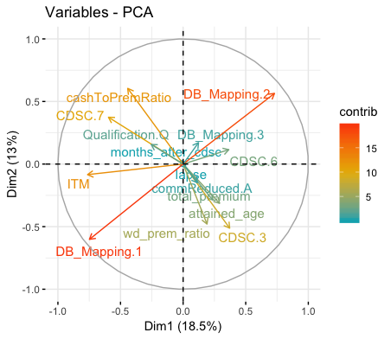
Variables
Variables
Predicted (Dependent): Lapse
Predictors (Independent):
Attained Age, Months after CDSC, In The Money, Cash Value to Total Premium Ratio, Withdrawal to Premium Ratio, Total Premium, CDSC, Commission Option, Death Benefit Mapping, Qualification Option
Numeric or one hot encoded factors determined by principal component analysis
Largest Contributors
Death Benefit Options (1 & 2)​
Cash Value : Total Premium​ (Ratio)
In The Money-ness
CDSC Options (years 3 & 7)

Slide 31
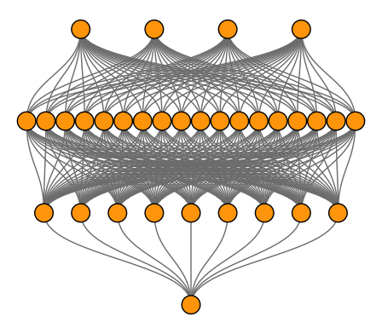
Model Configuration and Hyper-Parameters
Input Layer
14 Neurons (Predictors)
First Hidden Layer
Activation function: ReLU
128 Neurons
Second Hidden Layer
Activation function: ReLU
64 Neurons
Output Layer
Activation function: Tanh
1 Neuron
Hyperparameters
Learning Rate : 0.000001
Epochs : 150
Validation split : 0.4
Mini-batch size : 150
*Simplified

Slide 32
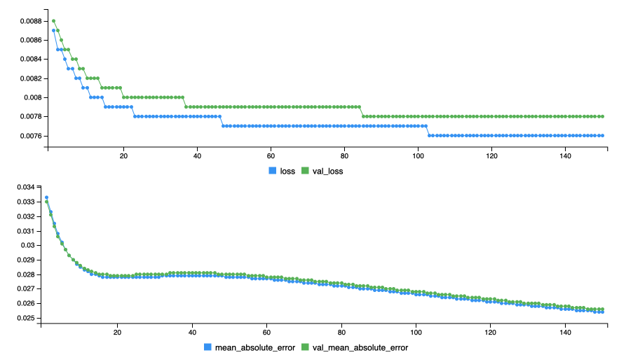
Model Performance
Loss Function
Optimization score function
Mean Square Error
Error Function
Performance metric
Mean Absolute Error
Good Model Performance!

Slide 33
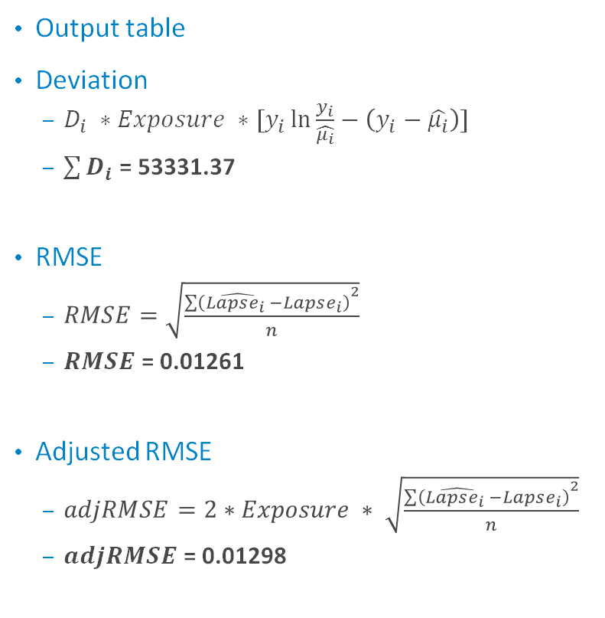
Results
Output table
Deviation
$D_{i} ∗Exposure ∗[y_{i}\ln{\frac{y_{i}}{\hat{μ_{i}}}}−\left(y_{i}−\hat{μ_{i}}\right)]$
$\sum{D_{i}}$ = 53331.37
RMSE
$RMSE=\sqrt{\frac{{\sum{\left(\hat{Lapse_{i} }−Lapse_{i}\right)}}^{2}}{n}}$
$RMSE$= 0.01261
Adjusted RMSE
$adjRMSE=2∗Exposure ∗ \sqrt{\frac{{\sum{\left(\hat{Lapse_{i} }−Lapse_{i}\right)}}^{2}}{n}}$
$adjRMSE$= 0.01298

Slide 34
Weaknesses of the Neural Network Model
The network is not very deep
Only two hidden layers
More layers = More computationally taxing
Larger networks should increase performance for large datasets
Larger Networks could lead to overfitting
Inputs must be numerical
One hot encoding loses some value of categorical variables
Optimization is difficult
Finding the optimal hyper-parameters is challenging

Slide 35
Model Comparison
Models
Generalized Linear Model – Poisson Regression
Highly interpretable parametirc model
Computationally efficient
Easily applicable to predict seriatim
RMSE = 0.08426
Random Forest
Less interpretable non-parametirc model
Comutationally efficient
Not easily applicable seriatim, aggregated model
RMSE = 0.0659
Artificial Neural Networks
Less interpretable non-parametric model
Computationally expensive
Easily applicable to predict seriatim
RMSE = .01298
 | GLM – Poisson | Random Forest | Neural Networks | Current PL GLM
Interpretability | 1 | 2 | 3 | 1
Computational Efficiency | 2 | 1 | 3 | 3
In Seriatim | 1 | 3 | 1 | 1
Model Performance | 3 | 2 | 1 | 4

Slide 36

Ensemble Learning
In machine learning, ensemble methods use multiple learning algorithms to obtain better predictive performance than could be obtained from any of the constituent learning algorithms alone.
Ensemble Learning is like …. fable of blind men and elephant

Slide 37
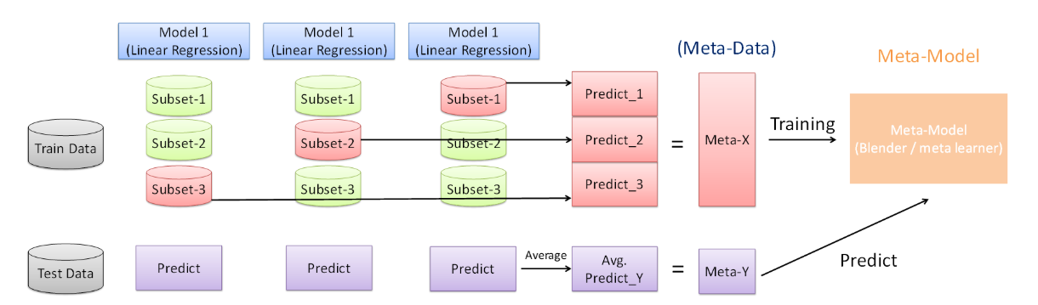
Ensemble – stage 1
Train each base model
Perform K-fold cross-validation on each model
Train base model and collect the predicted values to get Meta-X
Use test data to generate predictions from base model, and take an average to get Meta-Y

Slide 38
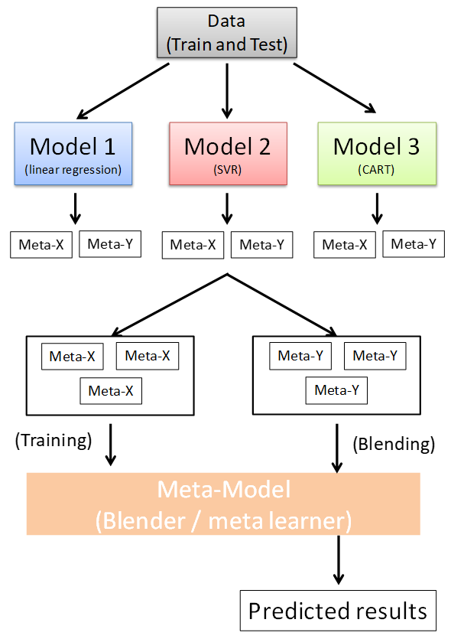
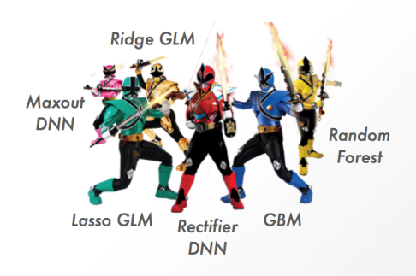
Ensemble – stage 2
Stack all base models
Stack each base model’s Meta-X to form a Meta-Leaner
Feed each base model’s predicted values of Meta-Y to Meta-Leaner to generate the ensemble prediction

Slide 39

Final Models and Results
 | Current Pacific Life Model (GLM) | Artificial Neural Network | Random Forest | Generalized Linear Model | Ensemble
Ensemble | X | X | O | O | O
RMSE | 0.09 | 0.01 | 0.06 | 0.08 | 0.05
Deviance | 46,115 | 53,331 | 67,426 | 42,766 | 59,490
Interpretability | 1 | 3 | 2 | 1 | 1
Computational Efficiency | 2 | 3 | 1 | 2 | 2
In Seriatim | 1 | 1 | 3 | 1 | 2
Model Performance | 3 | 1 | 2 | 3 | 2

Slide 40
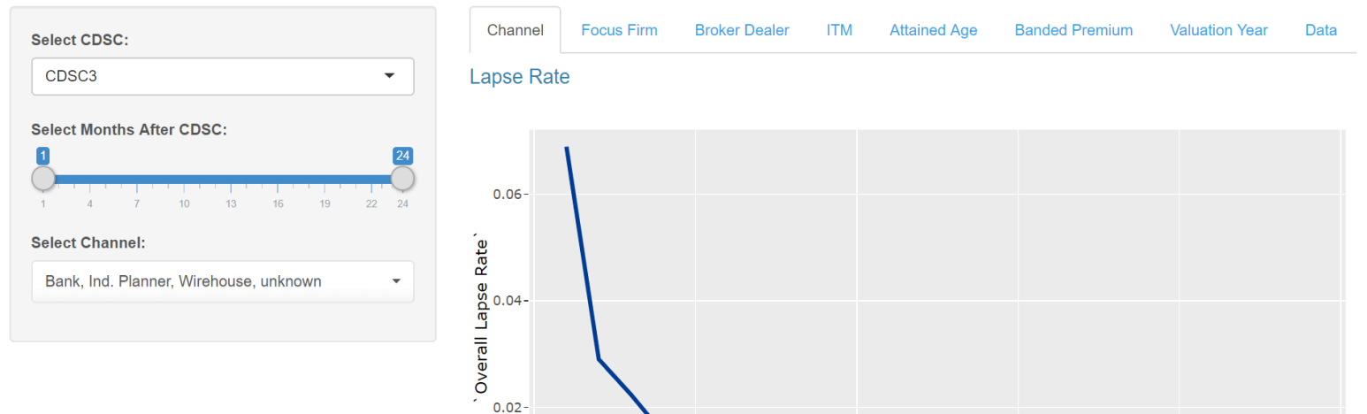
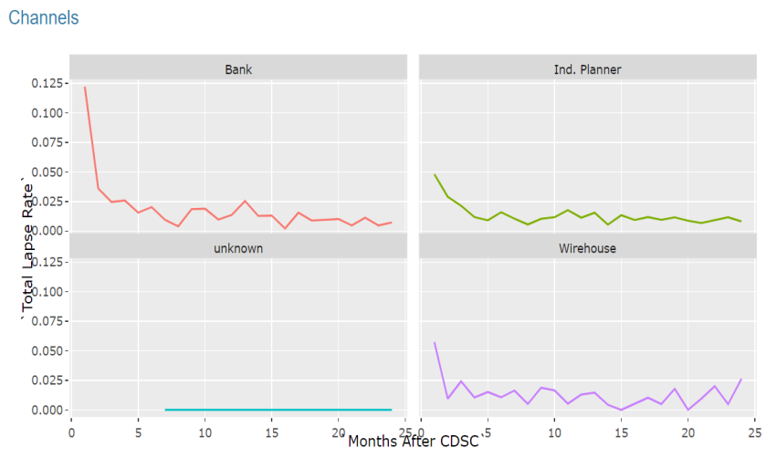
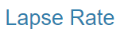
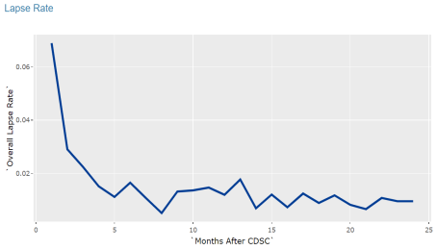
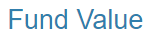
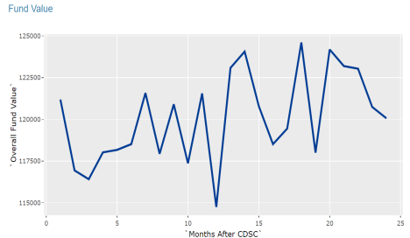
Channel
CDSC 3:
Bank 12.6%, Ind. Planner 5.6%, Wirehouse 2.9%

Slide 41
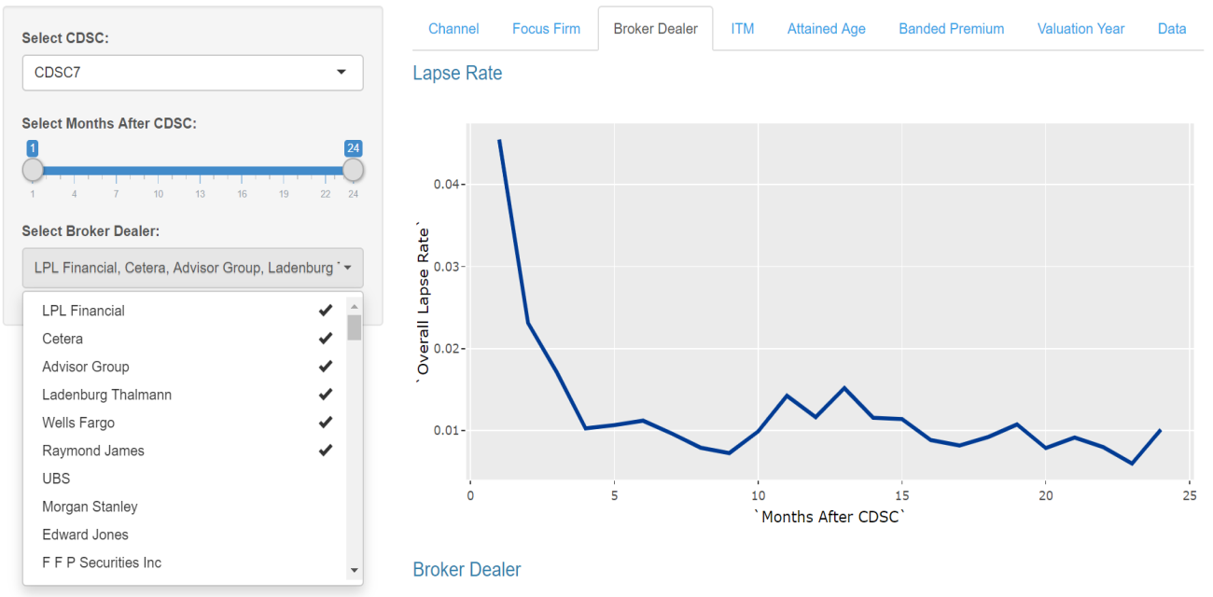
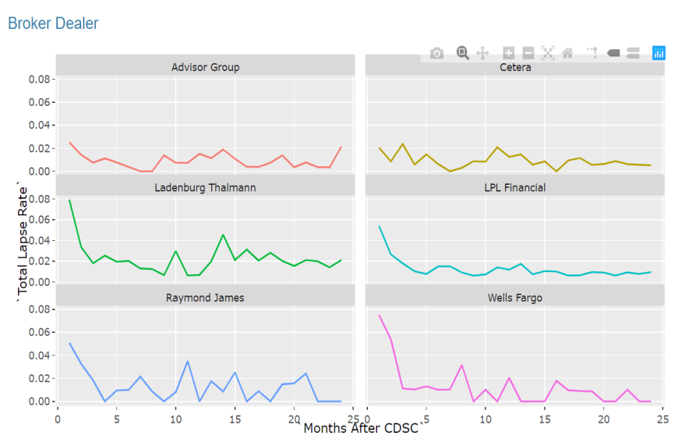
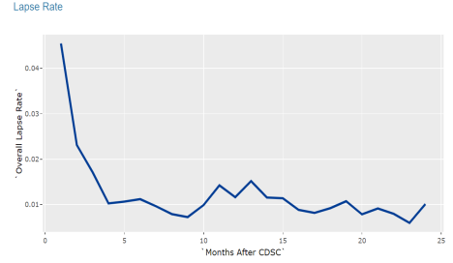
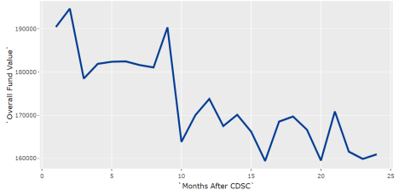
Broker Dealer

Slide 42
Thank you Any Questions?

